Slide 1
Robotic Farm
Supervisor:
Özkan Bebek
Umur Can Gürelli
Ali Baş

Slide 2
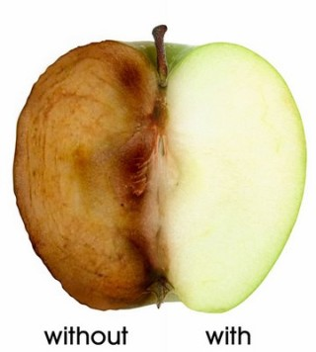
Motivation and Introduction
What will be the future of agriculture?
Chemicals on foods
Organic farming
White, B. (2012, November). Agriculture and the Generation Problem: Rural Youth, Employment and the Future of Farming
Harper, C. (2015, December). This computer will grow your food in the future. [Video file]. Retrieved from http://www.ted.com/talks/caleb_harper_this_computer_will_grow_your_food_in_the_future

Slide 3
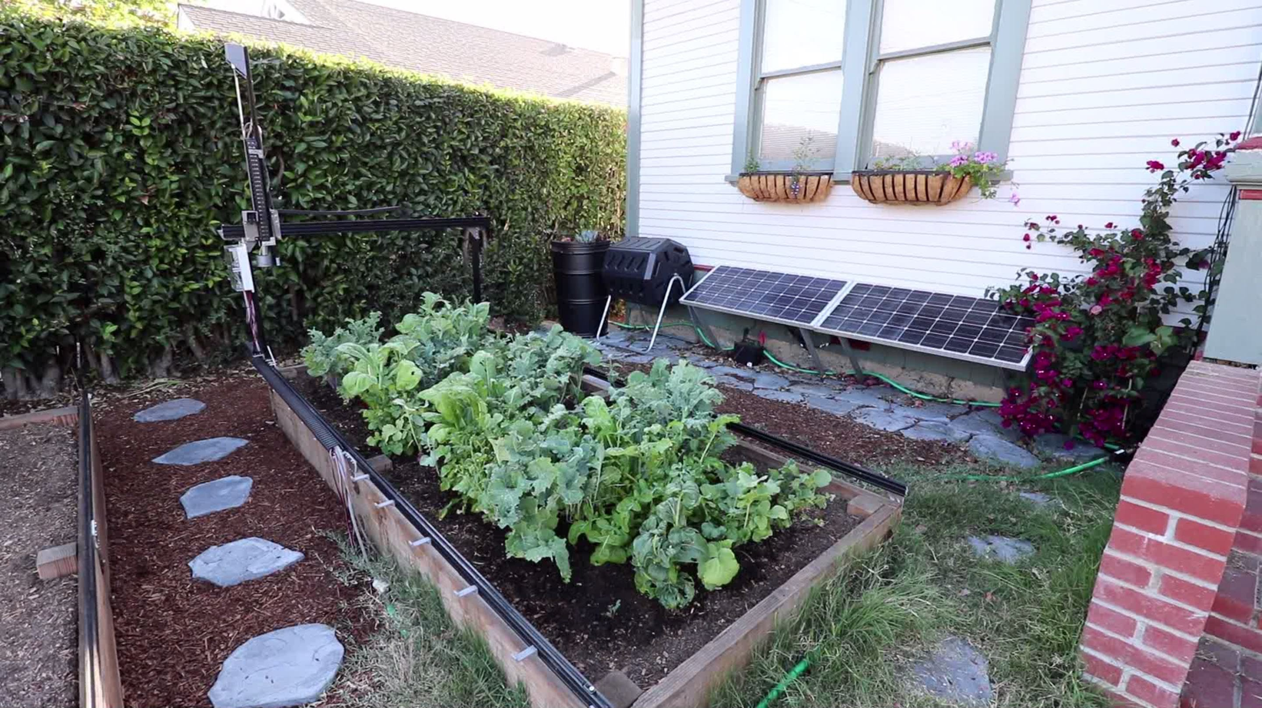
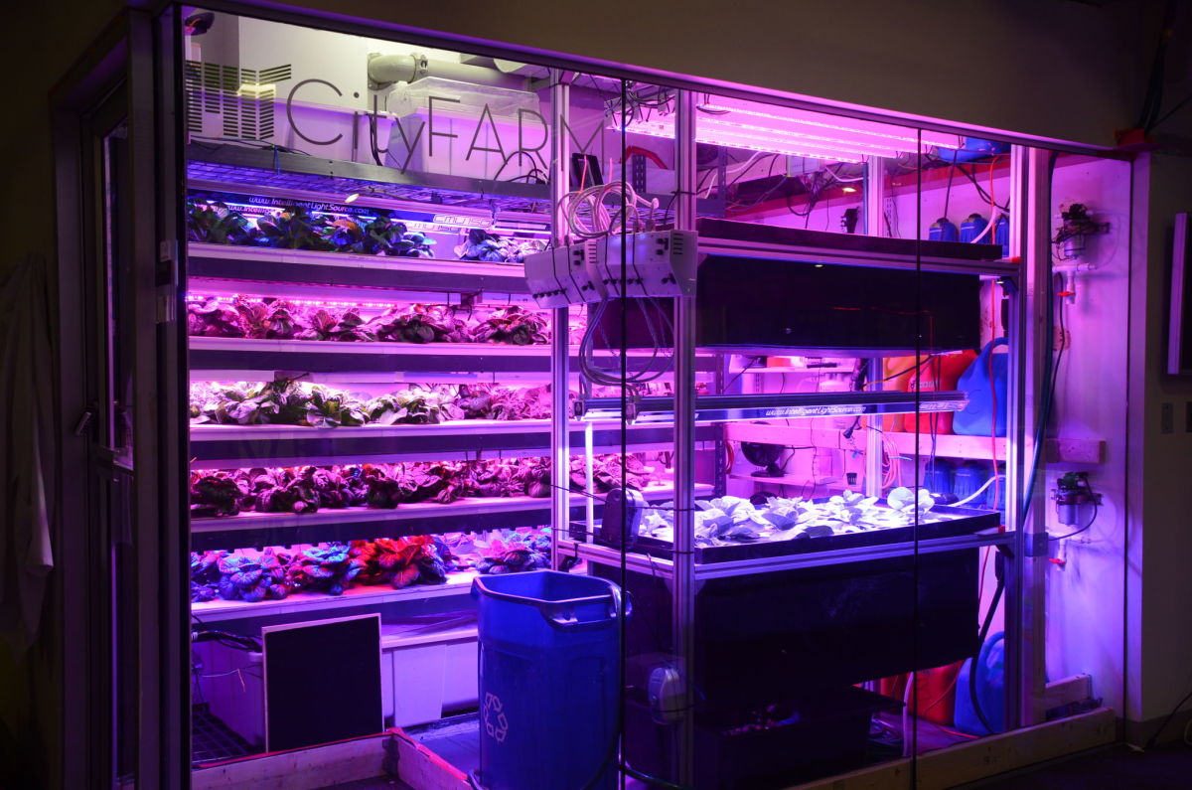
FarmBot
MIT’s Open Agriculture Initiative

Slide 4
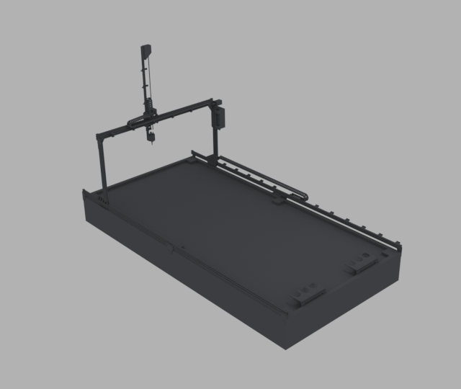
Definition of Project
Farm Bot - Completely autonomous farm
Different kind of plants
Continuously monitoring system
In and outdoor compatibility
Adjustable size

Slide 5
Objective
Design and development of a stable system.
Create a prototype of design.
Planting determined seeds.
Keeping the plants alive
Obtain data

Slide 6
Boundary and Operation Conditions
Lighting
Temperature
Humidity
Weight of mechanical components
Volume of system

Slide 7
Constraints
Cost
Manufacturing
Maintenance - Fouling factor with outdoor usage
Plants

Slide 8
Methodology
Modifications on Farm Bot designs.
Software Design (Control mechanisms, Image processing, Monitoring)
Analysing designs and making iterations for obtaining best result.
Manufacturing component parts
Assembling
Software Integration

Slide 9
Cost Analysis
Mechanical components
Electronic Hardware (Raspberry Pi 3, Arduino Mega, Nema 17 x 3)
Current cost estimation: 556$
Aimed cost: 400$

Slide 10
Timeline
 | October | November | December | January | February | March | April | May
Background Research
Evaluation and Deciding on Project
Literature Survey
Deciding on Design Methodology
Preparing and Confirming Component List
Mechanical Design
Software Design
Design and Thermal Analysis
Purchase of components and hardware
Building system
Software integration
Test - Planting
Analysis of Results (Harvesting)

